Slide 1

Use Case Model
Team 8 Weizhao Li & Peiyao Teng

Slide 2
Actors
Moderator:
The moderator is the person to create the group, populate the movies, invite others to join the group, create the vote, set up the event.
Participants:
Participants can join the group, unsubscribe the group, participate the vote, watch the trailers of the movies, view the reviews of the movies.
System:
The system will keep the history, elect the movie winner.
Team 8 Weizhao Li & Peiyao Teng

Slide 3
Use Cases
Moderator:
· Can Create a movie watcher’s group: set up a group, let other people join.
· Can invite people to join: join the watcher’s group.
· Can allow people to join: when the participant joins, need the moderator to confirm.
· Allow people to unsubscribe: allow participants to quit this group.
· Populate movie watcher’s groups with a list of potential movies : fetch the information from the API and showcase them in the group.
· Create a moving watching event: create a movie watching event that will occur in the specified date and time defined by the moderator.
· Open and close a voting period for a specific movie watching event: set up the voting, close the voting when it expires.

Slide 4
Use Cases
Participants:
· Can join the group: can join by the invitation from the moderator or asking for the request.
· Allow people to unsubscribe : allow participants to quit this group.
· Can search and browse the movies: can view the movies populated by the moderator.
· Can watch the trailer: can access to the links of trailers
· Access to the movie review: can access to the links of movie review.
· Can be notified that a movie watching event: can be notified the event and can vote for the movie that they want to watch in the event.
· Cast their votes：indicate what they want to watch.

Slide 5
Use Cases
Systems:
Can keep the history: Keep the history of movie watching events, votes, and winners.
Can elect a single movie winner for a movie watching event. (Not allow participants of a movie watching group to change their votes )

Slide 6
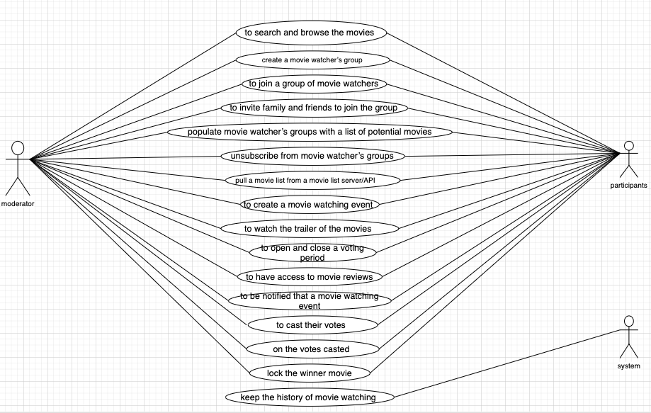
Use Cases Diagram

